Slide 1
CONFERENCING
WITH FLEET
NODE
Reel time communication made Real

Slide 2
TABLE OF CONTENTS
01
06
About the Project
Major Requirements
02
07
Idea – Context and Objective
Design - Project Stages
03
08
Project Term Definition
Architecture
Here we describe
About the project
Here we describe the
User Requirements
Here we describe the
Ideas and Objectives
Here we describe the
Project Design
Here we describe terms
Used in project
Here we describe the
Architecture of the page
04
09
Difficulties
Screenshot
Here we describe the difficulties
Faced by users without fleet
Here we describe
web wire Framings
05
10
Tech Stack
Completion Status
Here we describe the
Tech Stack used in the Project
Here we describe the
Completion status

Slide 3

ABOUT PROJECT
FLEET
Fleet is designed in order to give quality conferencing to people in urban and rural area with variety of scopes.
In today’s times where the pandemic has changed the way people even breathe it is necessary for the video conferencing service.

Slide 4
IDEA
Video Conferencing
Privacy in Communication
User Freindly

Slide 5
IDEA
Context:
-Video calls have become an integral part of today's communication.
-Only in the first four months of the COVID-19 pandemic was a 500% increase in search impressions for web and video conferencing software.
-And video chat apps continue growing in popularity with incredible speed both for businesses and personal use.
Objective:
-To build a video conferencing web app enabling users to have interactions over the internet.
-To implement the new industry standard for video conferencing i.e Webrt.
-To make a user base and identify different users on network.
-Allow sharing of messages during the video conferencing.
-To aid teaching with the help of whiteboard.

Slide 6
Key Features:
1. Hassle free google authentication
2. Fast streaming due to P2P architecture
3. Unique codes for meetings making easy to manage
4. Whiteboard streaming
5. Screen Sharing
6. Conference History Records

Slide 7
SOME PROJECT DEFINITION
WEBRTC
SOCKET.IO
NAVIGATOR-media devices
WebRTC (Web Real-Time Communication) is a technology that enables Web applications and sites to capture and optionally stream audio and/or video media, as well as to exchange arbitrary data between browsers without requiring an intermediary.
Socket.IO is a library that enables real-time, bidirectional and event-based communication between the browser and the server.
The Media Devices interface provides access to connected media input devices like cameras and microphones, as well as screen sharing. In essence, it lets you obtain access to any hardware source of media data.

Slide 8
TECH STACK
HTML
CSS
JS
NODE.JS
MONGO DB
AWS
SOCKET.IO
GSAP
WebRTC
BOOTSTRAP

Slide 9
REQUIREMENTS
A Laptop or a Desktop
Preferred Browser: Chrome, Edge, Brave, Mozzila with js support on
Active Internet Connection
Camera
Microphone
Speaker

Slide 10
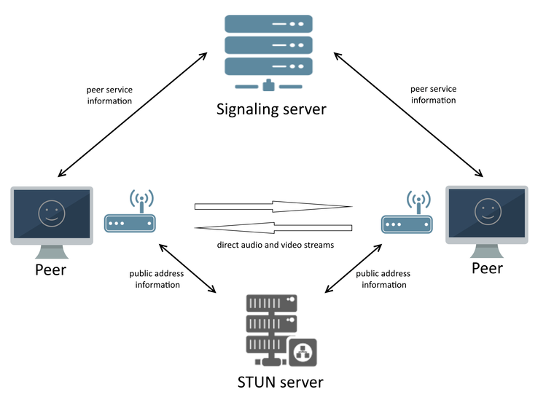

Slide 11
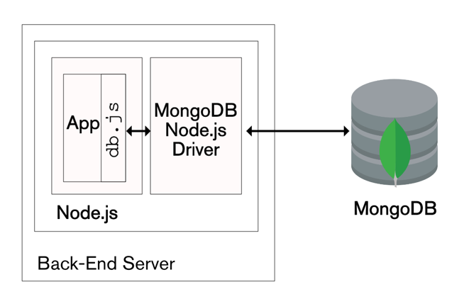

Slide 12
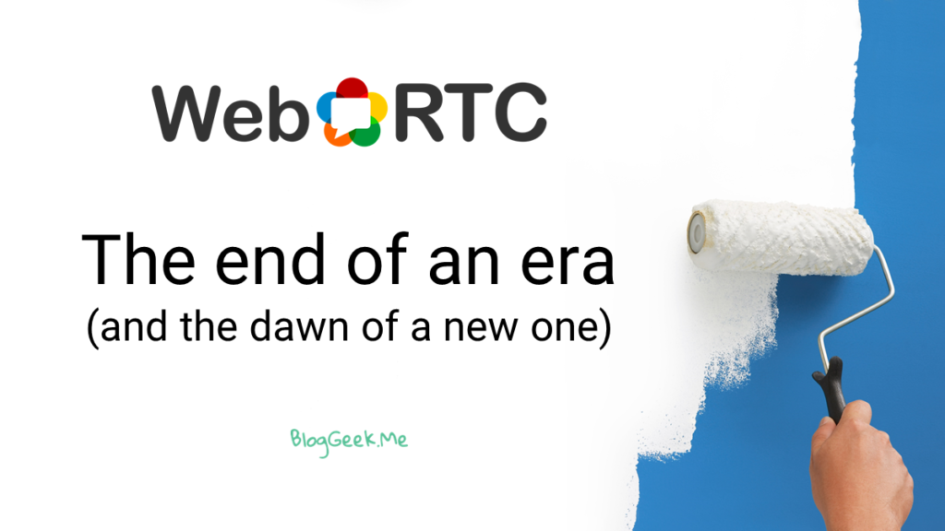

Slide 14
The pandemic had a positive effect on WebRTC adoption
The pandemic got us all quarantined and changed everything.
This is an important question. The appropriate answer is probably one of context. Your context is different from others.
Using proprietary real-time video is a hard problem to solve, so why not use WebRTC instead of solving it yourself?
Nobody knows you yet, so whatever others has going for it might not necessarily fit your situation And yet the WebRTC industry, its stack, the browsers and vendors are consistently being compared to others.
Your ability to compete with others on quality and connectivity is greatly dependent on Google, and what they decide to do with WebRTC.

Slide 15
WebRTC is an open framework for the web that enables real-time communications in the browser. It includes the fundamental building blocks for high-quality communications on the web, such as network, audio and video components used in voice and video chat applications.
Web Real-Time Communications (WebRTC) recently became a World Wide Web Consortium (W3C) recommendation and Internet Engineering Task Force (IETF) standard. This is a major milestone on a long journey for WebRTC that started in 2011 with Google open-sourcing key communication technologies and Ericsson implementing the ConnectionPeer API.
WebRTC came at a time when real-time communication (RTC) was complex and expensive, with audio and video technologies that either had to be licensed or developed in-house. Websites that used RTC (e.g., Skype, Facebook, Google Hangouts) often required downloading, installing, updating plugins or native applications — and occasionally, troubleshooting and user support. WebRTC sought to implement open standards for real-time, plugin-free video, audio, and data communication.

Slide 16
The year 2020 followed by 2021 has shown both how critical WebRTC already is in a world where travel and physical contacts need to be limited .
Organizations are leveraging WebRTC to conduct training, interviews, strategic planning, or as a substitute for in-person meetings to keep connected through happy hour and other social interactions - it is replacing not only in-person meetings, but it is now also replacing the human interactions inside offices. Domains such as healthcare and defense use WebRTC for training. Schools and universities have shifted to virtual learning platforms. Cloud gaming and social networks use live streaming and interactive broadcasts. Entertainment is trying to figure out how to bring the audience back to the studios by doing it remotely. Sports are trying to recreate the in-stadium experience using WebRTC. Families and friends make daily use of products that are built with WebRTC or parts of it.
The W3C also mentioned addressing emerging new use cases through future improvements and additions to the standard: live processing of audio, and video feeds (funny hats), file sharing, Internet of Things, machine learning, virtual reality gaming, untrusted JavaScript cloud conferencing, and more. Follows an example of machine learning algorithm (RAISR) that produces high-quality versions of low-resolution images:

Slide 17
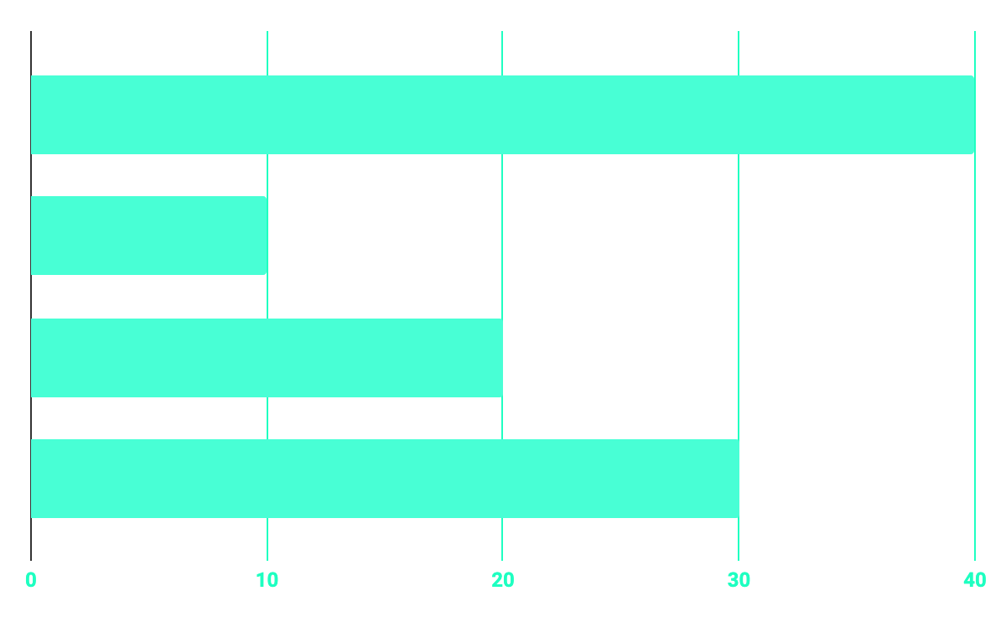
DIFFICULTY
SECURITY ISSUES
DATABASE DESIGN
IMPLEMENTING WEBRTC FROM SCRATCH
LONG CYCLE OF DEVELOPMENT

Slide 18
OUR TIMELINE
RESEARCH
IMPLEMENTATION
PLANING
PENDING
BUILD
FUNCTIONALITY
PRIVACY
About the project
Basic Webrtc connection
Room wise Calling Mechanism
Basic Web Server
Chat System

Slide 19
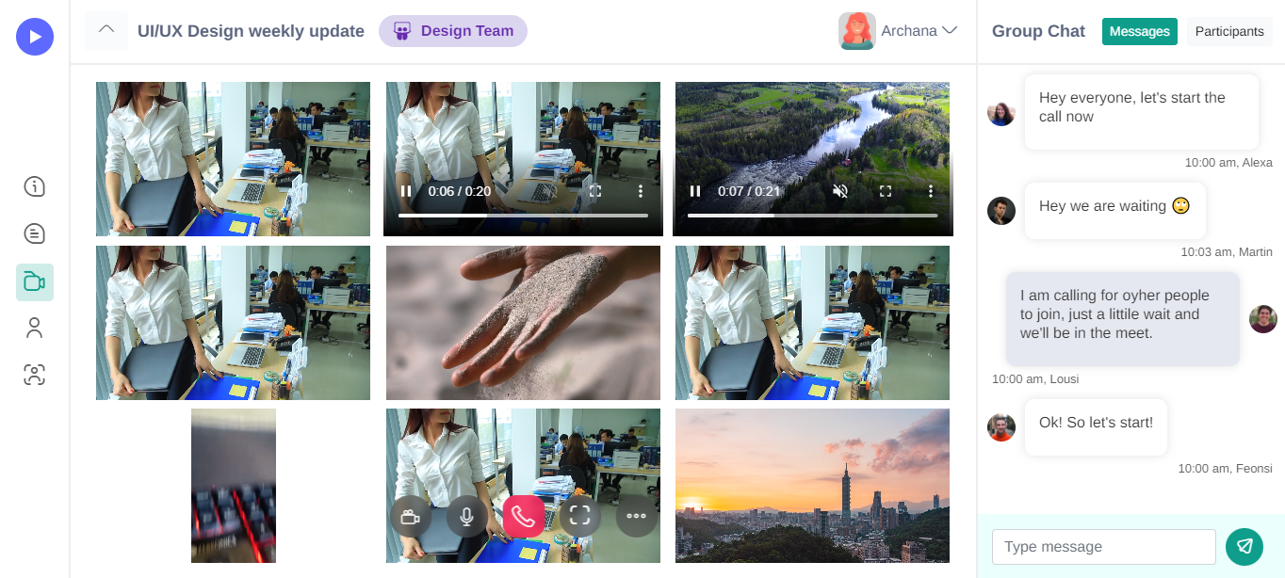

Slide 21
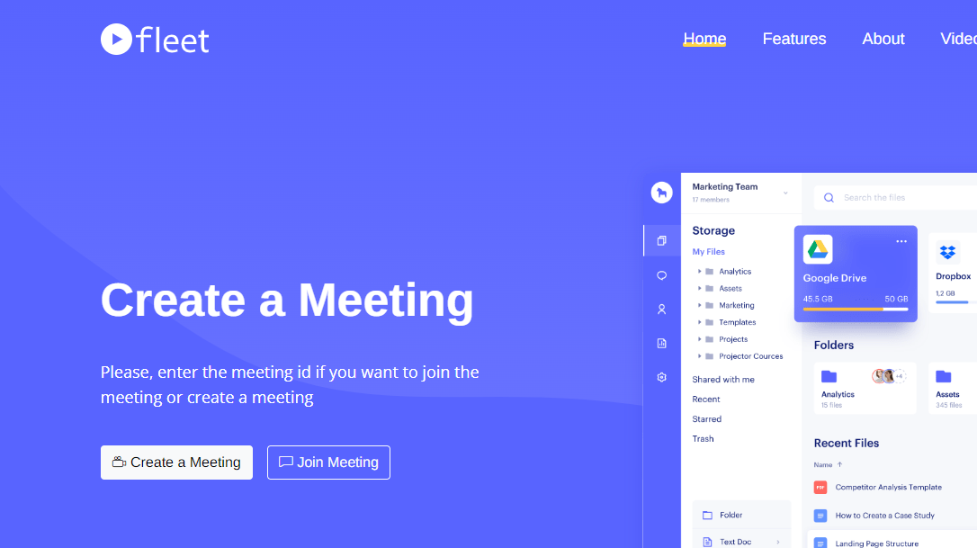

Slide 23
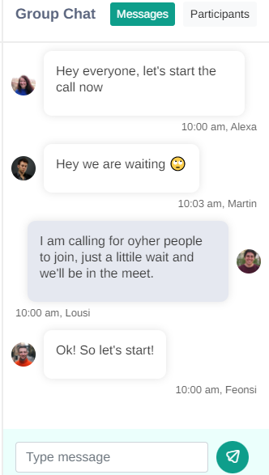
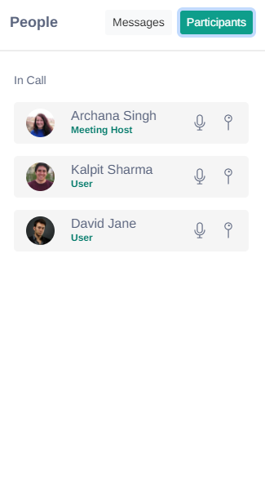
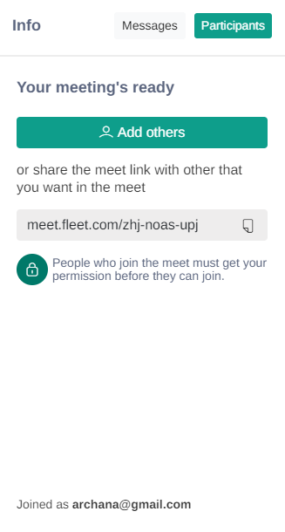


Slide 24
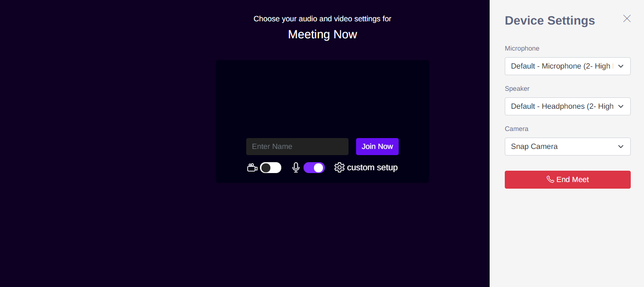

Slide 25
THE TEAM
SOHAM SHINDE
SHUBHAM PANDEY
HARSH GUPTA
-Team Lead
-Tester
-Backend Programmer
-Frontend Programmer
-Tester
-UI / UX
-Technical Writer
-Tester
-General Programmer

Slide 26
THANKS!
Team : Exceptional Pointers

